Slide 1
VII.3 SPM

Slide 2
Software metric
It’s a quantitative measure of an attribute a software system possesses with respect to Cost, Quality, Size and Schedule.
Example-
Measure - No. of Errors
Metrics - No. of Errors found per person

Slide 3
Cyclomatic complexity
It’s a software metric used to measure the complexity of a program. These metric, measures independent paths through program source code.
Independent path is defined as a path that has at least one edge which has not been traversed before in any other paths.
It can be calculated with respect to functions, modules, methods or classes within a program.

Slide 4
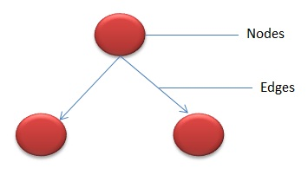
Contd..
In the graph, Nodes represent processing tasks while edges represent control flow between the nodes.

Slide 5
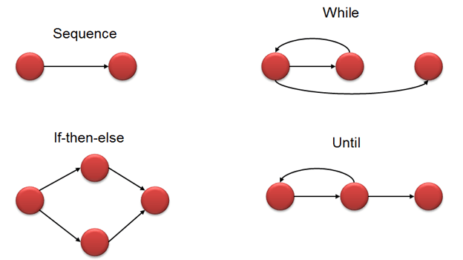
Flow graph notation for a program

Slide 6
Mathematical representation
The complexity of the program can be defined as:
V(G) = E - N + 2
Where,
E - Number of edges
N - Number of Nodes
V (G) = P + 1
Where P = Number of predicate nodes (node that contains condition)

Slide 7
Example
i = 0;
n=4; //N-Number of nodes present in the graph
while (i<n-1) do
j = i + 1;
while (j<n) do
if A[i]<A[j] then
swap(A[i], A[j]);
end do;
i=i+1;
end do;

Slide 8
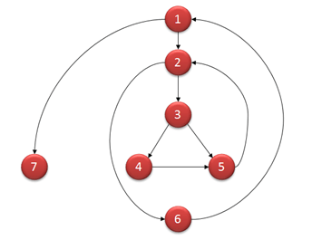
Flow graph-example

Slide 9
Mathematical Computation
V(G) = 9 - 7 + 2 = 4
V(G) = 3 + 1 = 4 (Condition nodes are 1,2 and 3 nodes)
Basis Set - A set of possible execution path of a program
1, 7
1, 2, 6, 1, 7
1, 2, 3, 4, 5, 2, 6, 1, 7
1, 2, 3, 5, 2, 6, 1, 7

Slide 10
Test case
This is the smallest unit of the testing plan - which includes a description of necessary actions and parameters to achieve and verify the expected behaviour of a particular function or the part of the tested software.
If you have a task to check some functionality, you can create a test script.

Slide 11
Contd..
Create test scenario as:
The user must be logged
Move to the "upload photos" page
Click the "upload" button
Select photos
Upload them

Slide 12
Step | Test Steps | Test Data | Expected Result | Actual Result | Status (Pass/Fail) | Notes
1
2
3
4
Project Name:
Test Case
Test Case ID: | Test Designed by:
Test Priority (Low/Medium/High): | Test Designed date:
Module Name: | Test Executed by:
Test Title: | Test Execution date:
Description:
Pre-conditions:
Dependencies:
Post-conditions:

Slide 13
Basis path testing
One of the white box testing and it guarantees to execute at least one statement during testing. It checks each linearly independent path through the program, which means number test cases, will be equivalent to the cyclomatic complexity of the program.
This metric is useful because of properties of Cyclomatic complexity (M) -
M can be number of test cases to achieve branch coverage (Upper Bound)
M can be number of paths through the graphs. (Lower Bound)

Slide 14
Alpha testing
Alpha testing is a type of acceptance testing; performed to identify all possible issues/bugs before releasing the product to everyday users or public. The focus of this testing is to simulate real users by using blackbox and whitebox techniques.
The aim is to carry out the tasks that a typical user might perform. Alpha testing is carried out in a lab environment and usually the testers are internal employees of the organization. To put it as simple as possible, this kind of testing is called alpha only because it is done early on, near the end of the development of the software, and before beta testing.

Slide 15
Beta testing
Beta Testing of a product is performed by "real users" of the software application in a "real environment" and can be considered as a form of external user acceptance testing.
Beta version of the software is released to a limited number of end-users of the product to obtain feedback on the product quality. Beta testing reduces product failure risks and provides increased quality of the product through customer validation.
It is the final test before shipping a product to the customers. Direct feedback from customers is a major advantage of Beta Testing. This testing helps to tests the product in real time environment.

Slide 16
Agile
Agile is an iterative approach to project management and software development that helps teams deliver value to their customers faster and with fewer headaches. Requirements, plans, and results are evaluated continuously so teams have a natural mechanism for responding to change quickly.

Slide 17
Case study 7: Find cyclomatic complexity and test case of following code
a=10
If b>c then
a=b
Else
a=c
Endif
Print a
Print b
Print c

